Slide 1



CORONA VIRUS ANALYSIS WITH SQL
ONUH THERESA
MIP-DA-07

Slide 2

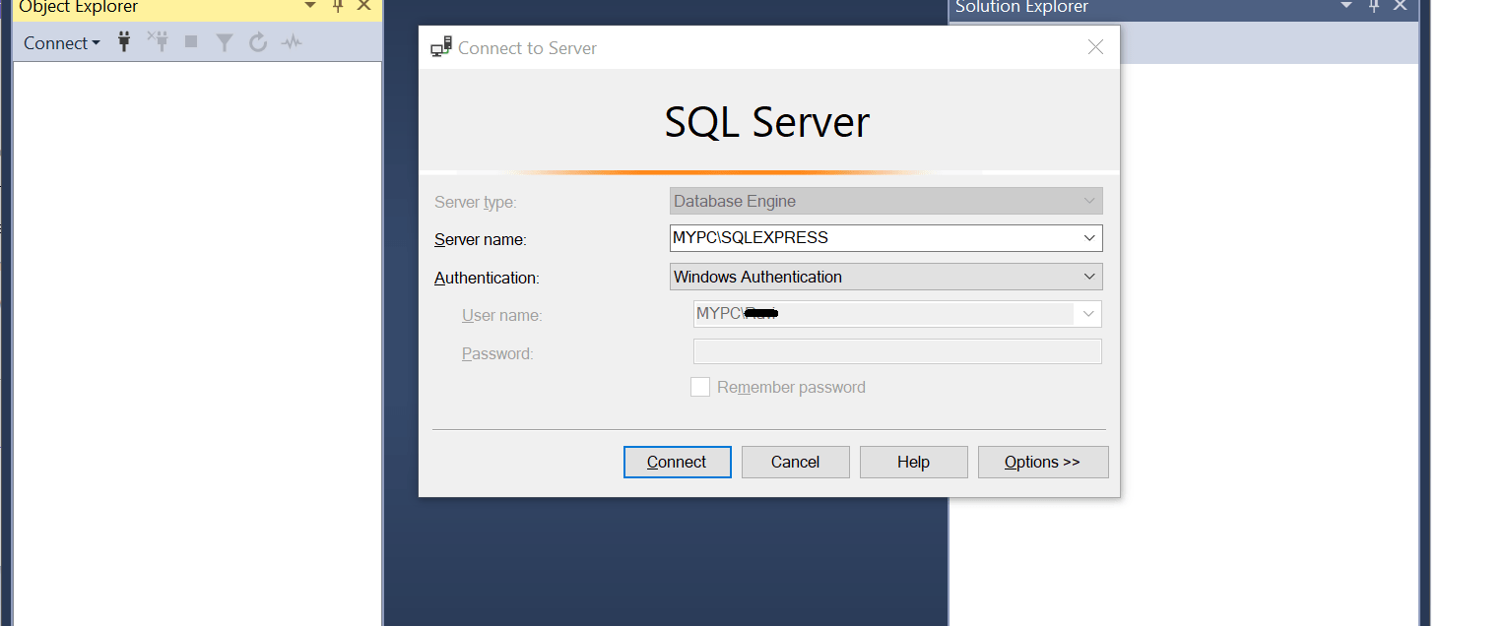
Database used

Slide 3

PROJECT OVERVIEW
The Corona Virus pandemic had a significant impact on public health and created an urgent need for data driven insights to understand its spread. Hence, the aim of this project is to uncover patterns, trends and correlations in the dataset.

Slide 4

Dataset overview Description of each column in the dataset
PROVINCE : Geographic subdivision within country or region.
COUNTRY/REGION : Geographic entity where data is recorded.
LATITUDE : North-South position on Earth's surface.
LONGITUDE :East-West position on Earth's surface.
DATE : Recorded date of corona virus data.
CONFIRMED : Number of diagnosed corona virus cases.
DEATHS : Number of corona virus related deaths.
RECOVERED : Number of recovered corona virus cases.

Slide 5
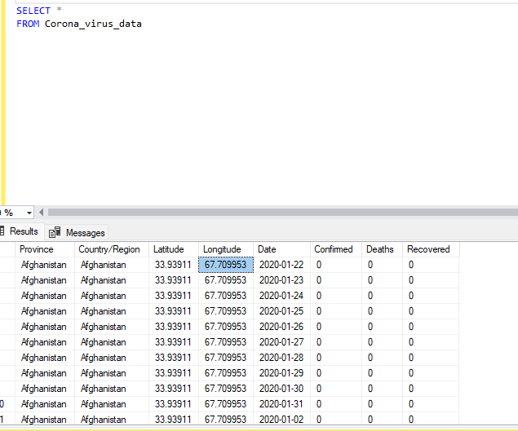

Slide 6
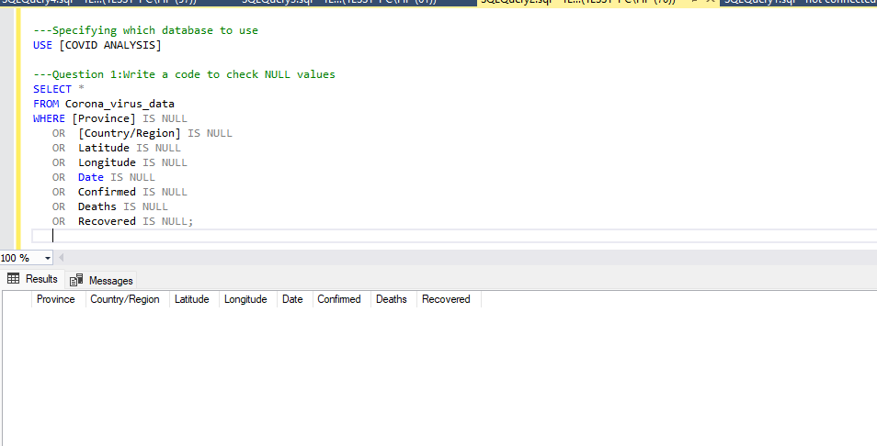
Inference: There are no NULL values in the Dataset
Q1: Write a query to check for NULL values

Slide 7
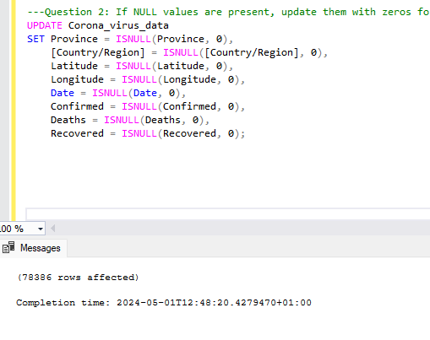
Q2: If NULL values are present ,update with zero for all columns
INFERENCE: There are no NULL values, so our data remains the same

Slide 8
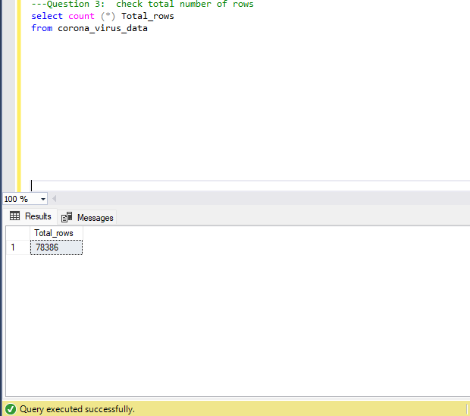
Q3: Check Total number of rows
There are a total of 78,386 rows in the dataset

Slide 9
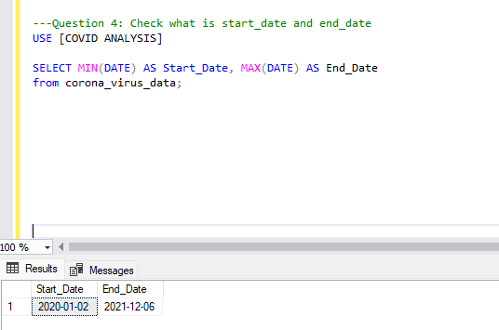
Q4: Check what is the start date and end date?

Slide 10
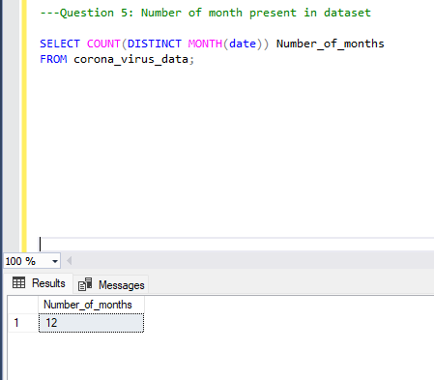
Q5: Number of months present in dataset

Slide 11
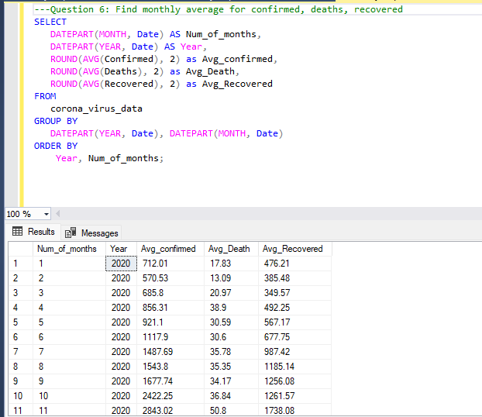
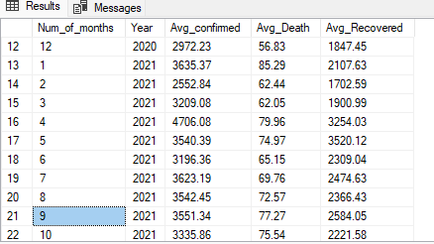
Q6: Find the monthly average for confirmed cases, deaths and recovered.

Slide 12
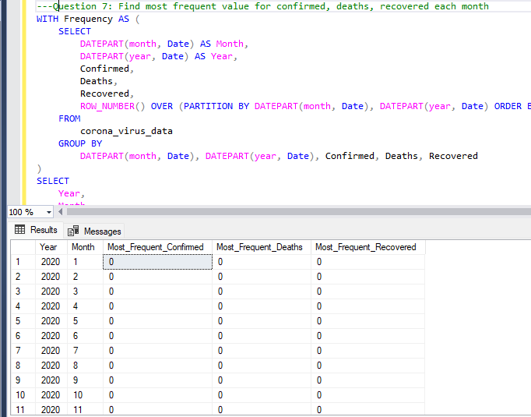
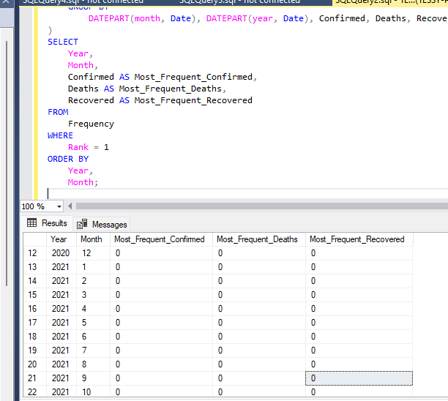
Q7:Find most frequent value for confirmed ,deaths and recovered each month.

Slide 13
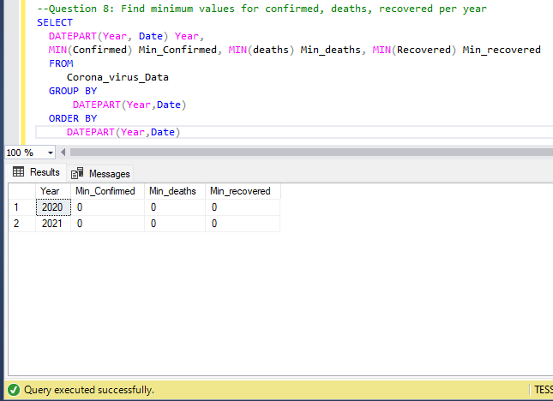
Q8: Find the minimum values for confirmed ,deaths, recovered per year

Slide 14
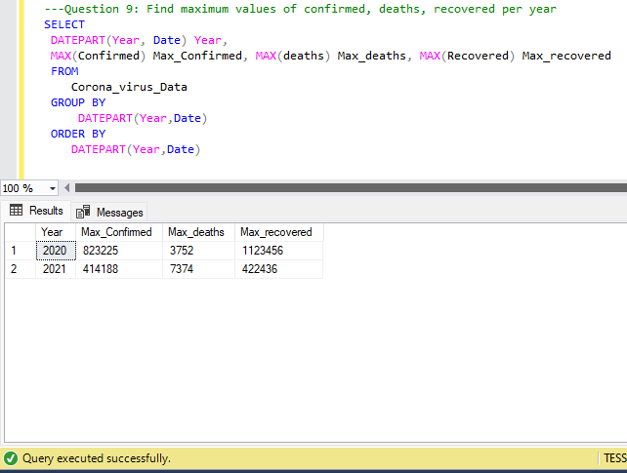
Q9:Find the maximum values for confirmed, deaths, recovered per year.

Slide 15
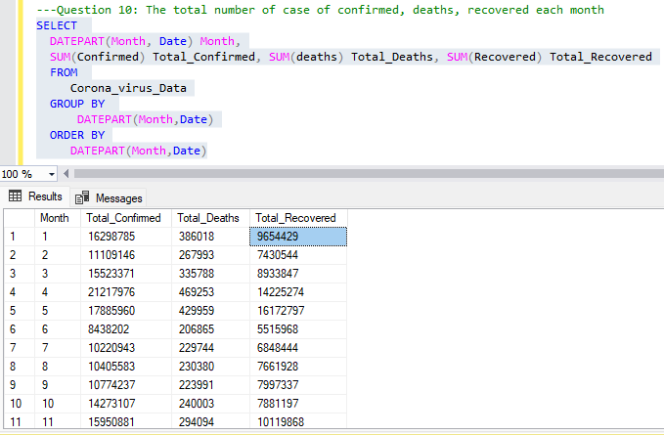
Q10:Find the total number of confirmed, deaths, recovered each month.

Slide 16
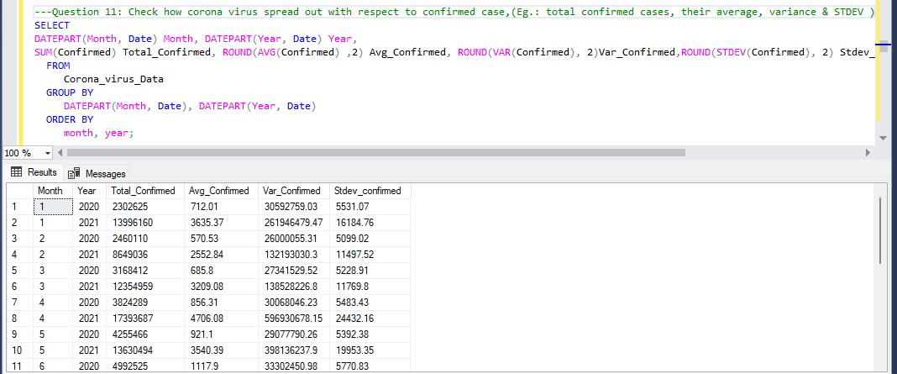
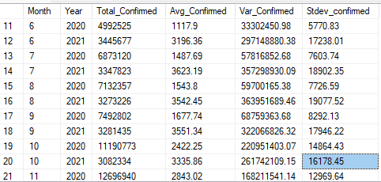
Q11: Check how coronavirus spread out with respect to confirmed cases(Total, Avg, Variance and STDEV).

Slide 17
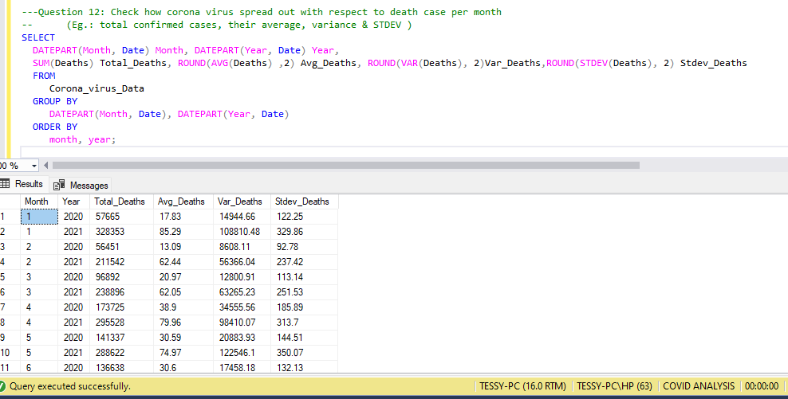
Q12:Check how corona virus spread out with respect to death case per person.

Slide 18
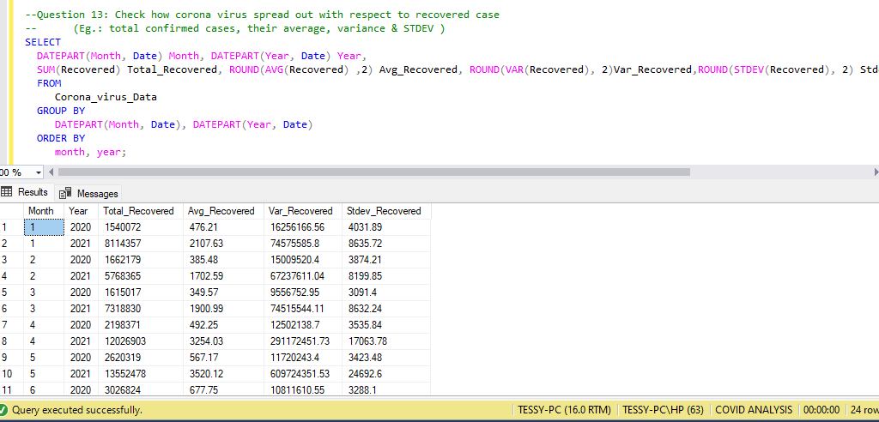
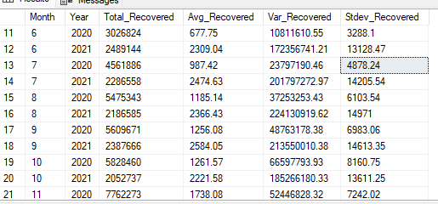
Q13:Check how corona virus spread out with respect to recovered case.

Slide 19
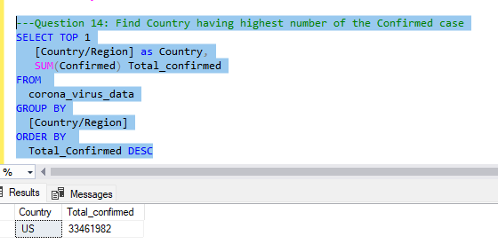
Q14: Find the country having the highest number of confirmed cases.

Slide 20
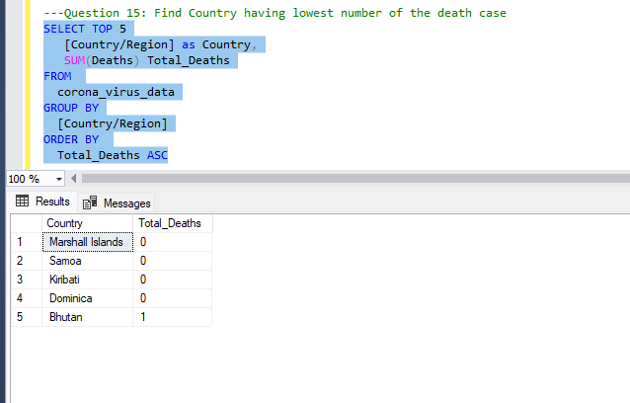
Q15: Find country having lowest number of death case.

Slide 21
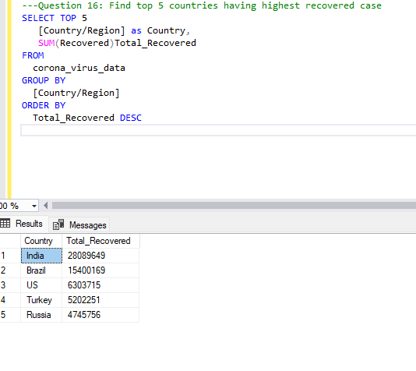
Q16: Find Top 5 countries having highest recovered case.

Slide 22

INSIGHTS (According to Data)
The United States had the highest number of confirmed cases but was still among the top 5 with high recovery rates.
India had the highest number of Recovery rates.
The number of confirmed cases, death and recovery in 2020 was high compared to 2021, but death rate in 2021 still recorded higher than 2020.
Marshall islands , samoa ,kribati, Dominica recorded the lowest death rates.
Confirmed cases ,recovered and deaths recorded highest in the year 2021.
The corona virus started in January 2020 and ended in June 2021.

Slide 23

THANK YOU

